Slide 1
Test Automation With Selenium
Introduction

Slide 2


Course Content
01
QA Process + Selenium
02
Selenium + TestNG
02
03
Elements Handeling
03
04
Page Object Model With Selenium
04
05
CI/CD Intergration
06
AI + Test Automation

Slide 3
Guidelines
01
Clear Explanation
02
On Call / Message Support
02

Slide 4
Support Channels
Whatsapp Number - +94 70 349 8259
Email - learntestautomations@gmail.com

Slide 5


Our Trannings
Test Automation
With
Selenium
(Batch 31)
Test Automation
with
Playwright
(Batch 01)
Java
For
Automation
Tester
(Batch 02)
API Automation
With
SoapUI
(Batch 01)
Presentations are communication tools that can be used as demonstrations, lectures, speeches, reports, and more. It serves a variety of purposes, making presentations powerful tools for convincing and teaching.

Slide 6



Why Need Software Quality Assurance?

Slide 7
Roles In a IT Company
Project Manager
Business Analyst
Software Engineers
UI Engineers
Database Engineers
QA Engineers
Automation Engineers

Slide 8

Process
I want a Web Application to save my employees Name, Address, Numbers and delete employees details
BA
+
Project Manager
Client

Slide 9


Break down Project Tasks
Login
Add Employees
Remove Employees

Slide 10

How can i Manage this Project

Slide 11
Project Mangment Tools/Documents
JIRA
SRS
Asana
Shortcut
MS Project

Slide 12



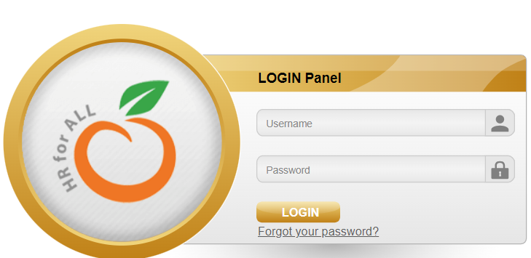
SRS/JIRA
BA
+
Project Manager
Developer
+
UI Engineers
+
QA Engineers
System
Software Tester
1
2
3
4
Using
Test Case

Slide 13
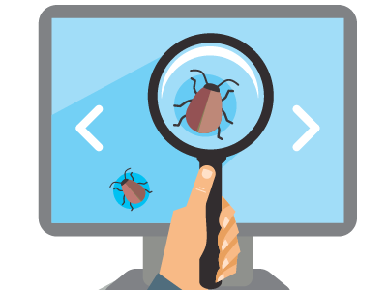
Bug/Defect
Test Case Expected Result /Requirement Actual Result

Slide 14
Login Page Is Done
http://orangehrm.qedgetech.com/
Valid Username – Admin
Valid Password – 123

Slide 15

Let’s Start
Username | Password
Manual Test Steps For One Possibilities
  [01]. Open Chrome Browser
  [02]. Go to the site
  [03]. Type Valid Username
  [04]. Type Invalid password
  [05]. Click Login Button
  [06]. Verify Error Message

Slide 16
Let’s Start
Username | Password
Automation Test Steps For One Possibilities
  [01]. Open Chrome Browser Automatically
  [02]. Go to the site Automatically
  [03]. Type Valid Username Automatically
  [04]. Type Invalid password Automatically
  [05]. Click Login Button Automatically
  [06]. Verify Error Message Automatically

Slide 17
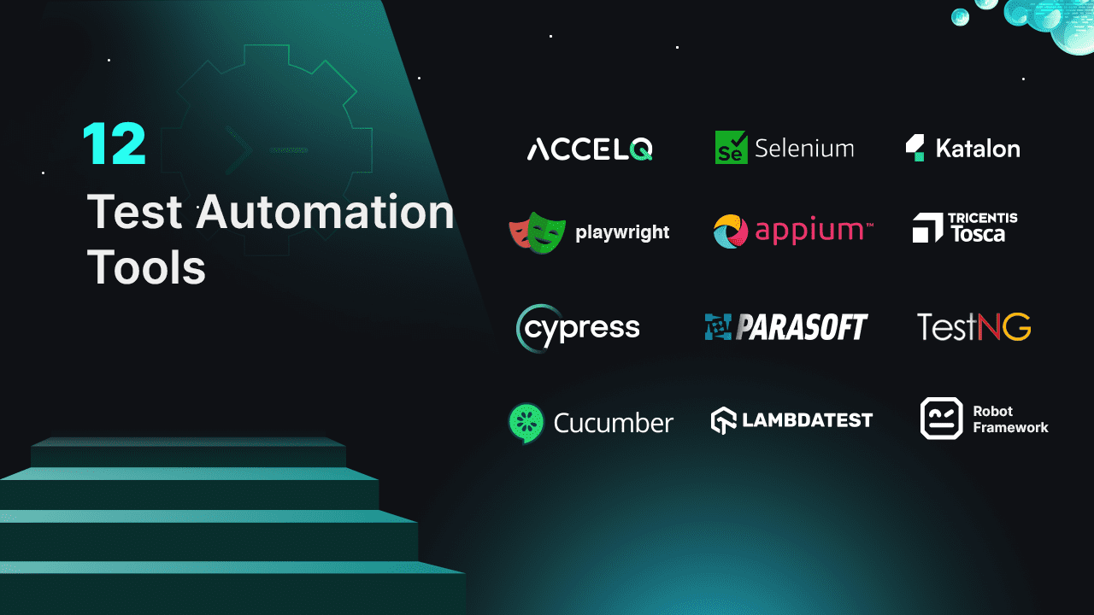
How Automate?
Selenium
Squish
Ranorex
Cypress
QTP

Slide 18
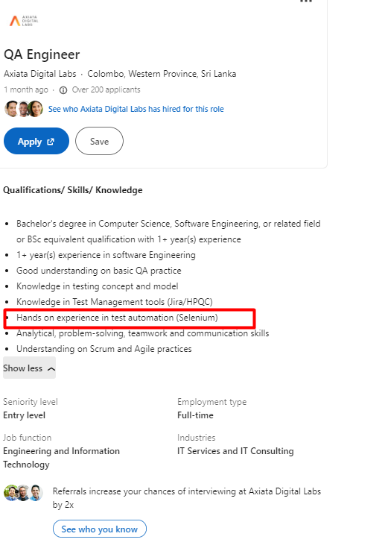
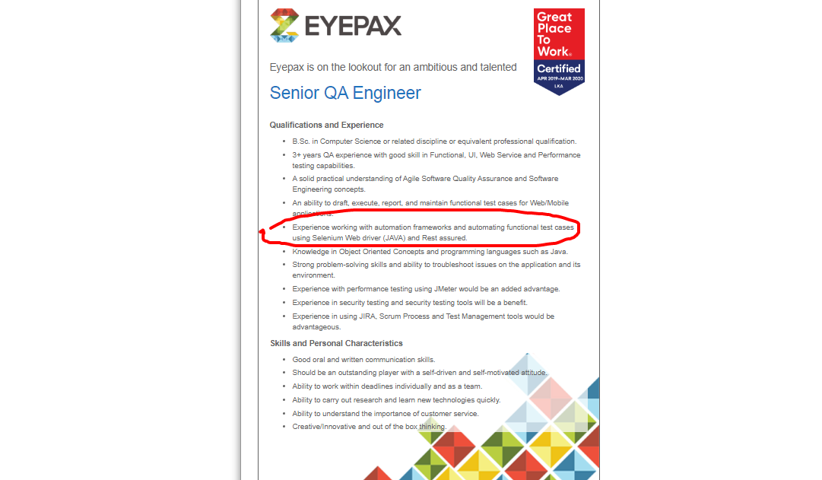
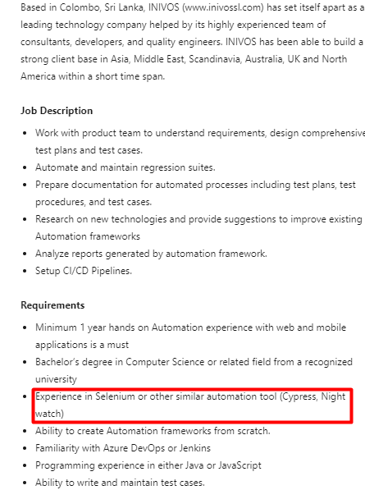
Why Selenium?

Slide 19
Why Selenium?
It’s free, open-source
Supports multiple languages
Works with all major browsers

Slide 20


What is Selenium
What is Selenium –
Test Automation Tool Suite?
Jason Huggins
Birth of selenium
“Selenium”
https://www.selenium.dev/

Slide 21
Selenium Suite
Selenium Integrated Development Environment (Selenium IDE)
Selenium Remote Controller (RC)
Selenium WebDriver
Selenium Grid

Slide 22
Selenium Suite
Selenium Suit
Selenium IDE
Selenium RC
Selenium WebDriver
Selenium GRID

Slide 23
Selenium Suite
Selenium Suit
Selenium IDE
Selenium RC
Selenium WebDriver
Selenium GRID
Selenium WebDriver 2
2011
Selenium WebDriver 3
2016
Selenium WebDriver 4
2021

Slide 24
Selenium Suite
Selenium Suit
Selenium IDE
Selenium WebDriver
Selenium GRID

Slide 25
01. Webdriver (Selenium)
Selenium Webdriver is an API ?
programming languages
    Java
    PHP
    C#
    Python
    Ruby

Slide 26



3
1
2
Resources
Lunch
(Request)
Mother
(API)

Slide 27
3
Resources
Open Browser
(chromeDriver)
Type
(SendKeys)
Click
(Click)
1
2
WebDriver API
Requests
  Browser Automation

Slide 28
java
JDK
JRE
Check your java version

Slide 29
Minimum Java version Support to Selenium
Java 11

Slide 30
InteliJ IDEA
IntelliJ IDEA is an Integrated Development Environment (IDE) for Java and Kotlin designed to maximize developer productivity.
https://www.jetbrains.com/idea/download

Slide 31
Maven
Maven is a Build Managment Tool
  Project Activities
    Writing Code
    Compile Code
    Run Code
Maven is a Dependency mangment Tool

Slide 32
Let’s Start
Test Case – (Refer Test Case - Login Document)
  [01]. ..
  [02]. ..
  [03]. ..
  [04]. ..
  [05]. ..
  [06]. ..

Slide 33
Automation Steps
  [01]. Open Browser(Chrome) Automatically
  [02]. Type URL as http://orangehrm.qedgetech.com/ Automatically
  [03]. Type Username “Admin” (Valid username) Automatically
  [04]. Type Password “123” (Invalid Password) Automatically
  [05]. Click Login Button Automatically
  [06]. Verify “Invalid credentials” Message Automatically

Slide 34
What we need to automate?
Programming language - Java
Programming tool - InteliJ IDEA
Selenium Webdriver API

Slide 35
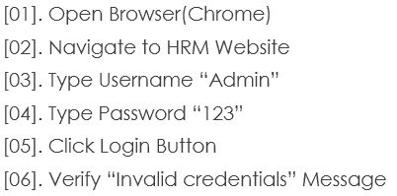
Open Chrome Browser Using Selenium

Slide 36
Navigate to HRM Website

Slide 37
Type Username “Admin”
Type Password “123”

Slide 38

Locating Elements
Why locate elements in a webpage
Name
Name
ID
ID

Slide 39
Type Username “Admin”
Type Password “123”

Slide 40
Can use Id and Name Always ?
http://mavenrepository.com
Inspect Search Button ?

Slide 41
Click Login Button

Slide 42
SRS / Test case Defined
Verify “Invalid Credentials”
    Invalid Password
    Password is wrong

Slide 43
Basic Commands we learned
  Window Maximize
  Chromedriver
  Get
  SendKeys
  Click
  Close
Selenium API

Slide 44
Automation Practice Task 01
Login to the <Your System>

Slide 45
Automation Practice Task 02
Navigate to the Maven Repository and type “Selenium” and click search, then select Selenium Java {New Project}
Write and automate Test cases for ‘’

Slide 46
Identified Limitation
Limitation of verify statement
More java less Selenium
Complex with more elements
No: of classes

Slide 47
TestNG
Framework with Selenium

