Slide 1
Test Automation With Selenium
Introduction

Slide 2


What is Selenium
What is Selenium –
Test Automation Tool Suite?
Jason Huggins
Birth of selenium
“Selenium”
https://www.selenium.dev/

Slide 3
Selenium Suite
Selenium Integrated Development Environment (Selenium IDE)
Selenium Remote Controller (RC)
Selenium WebDriver
Selenium Grid

Slide 4
Selenium Suite
Selenium Suit
Selenium IDE
Selenium RC
Selenium WebDriver
Selenium GRID

Slide 5
Selenium Suite
Selenium Suit
Selenium IDE
Selenium RC
Selenium WebDriver
Selenium GRID
Selenium WebDriver 2
2011
Selenium WebDriver 3
2016
Selenium WebDriver 4
2021

Slide 6
Selenium Suite
Selenium Suit
Selenium IDE
Selenium WebDriver
Selenium GRID

Slide 7
01. Webdriver (Selenium)
Selenium Webdriver is an API ?
programming languages
    Java
    PHP
    C#
    Python
    Ruby

Slide 8



3
1
2
Resources
Lunch
(Request)
Mother
(API)

Slide 9
3
Resources
Open Browser
(chromeDriver)
Type
(SendKeys)
Click
(Click)
1
2
WebDriver API
Requests
  Browser Automation

Slide 10
java
JDK
JRE
Check your java version

Slide 11
Minimum Java version Support to Selenium
Java 11

Slide 12
InteliJ IDEA
IntelliJ IDEA is an Integrated Development Environment (IDE) for Java and Kotlin designed to maximize developer productivity.
https://www.jetbrains.com/idea/download

Slide 13
Maven
Maven is a Build Managment Tool
  Project Activities
    Writing Code
    Compile Code
    Run Code
Maven is a Dependency mangment Tool

Slide 14
Let’s Start
Test Case – (Refer Test Case - Login Document)
  [01]. ..
  [02]. ..
  [03]. ..
  [04]. ..
  [05]. ..
  [06]. ..

Slide 15
Automation Steps
  [01]. Open Browser(Chrome) Automatically
  [02]. Type URL as http://orangehrm.qedgetech.com/ Automatically
  [03]. Type Username “Admin” (Valid username) Automatically
  [04]. Type Password “123” (Invalid Password) Automatically
  [05]. Click Login Button Automatically
  [06]. Verify “Invalid credentials” Message Automatically

Slide 16
What we need to automate?
Programming language - Java
Programming tool - InteliJ IDEA
Selenium Webdriver API

Slide 17

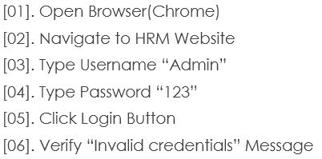
Open Chrome Browser Using Selenium

Slide 18
Navigate to HRM Website

Slide 19
Type Username “Admin”
Type Password “123”

Slide 20

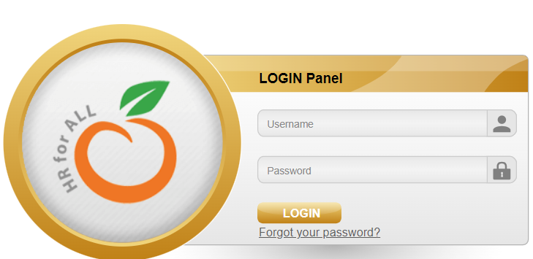
Locating Elements
Why locate elements in a webpage
Name
Name
ID
ID

Slide 21
Type Username “Admin”
Type Password “123”

Slide 22
Can use Id and Name Always ?
http://mavenrepository.com
Inspect Search Button ?

Slide 23
Click Login Button

Slide 24
SRS / Test case Defined
Verify “Invalid Credentials”
    Invalid Password
    Password is wrong

Slide 25
Basic Commands we learned
  Window Maximize
  Chromedriver
  Get
  SendKeys
  Click
  Close
Selenium API

Slide 26
Automation Practice Task 01
Login to the <Your System>

Slide 27
Automation Practice Task 02
Navigate to the Maven Repository and type “Selenium” and click search, then select Selenium Java {New Project}
Write and automate Test cases for ‘’

Slide 28
Identified Limitation
Limitation of verify statement
More java less Selenium
Complex with more elements
No: of classes

Slide 29
TestNG
Framework with Selenium

